Slide 1
Bioinformatics Analysis Workflows: Nextflow Tower
Introduction to Bioinformatics — Module 2
Erkison Ewomazino Odih
20 October 2021

Slide 2

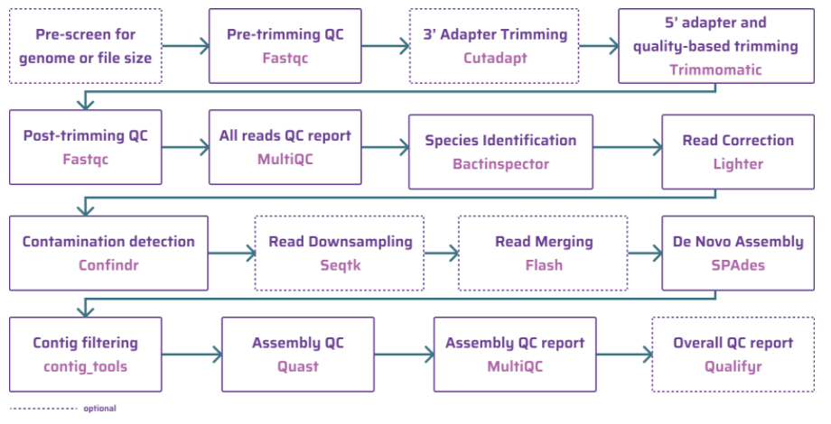

Why do we need pipelines?
Raw sequence
Enthusiastic Bioinformatician
(Day 1)

Slide 3
Why do we need pipelines?
Raw sequence
Enthusiastic Bioinformatician
(Day 2)

Slide 4


Why do we need pipelines?
Raw sequence
Ok, I’m out!
Dejected Bioinformatician
(Day 3)

Slide 5
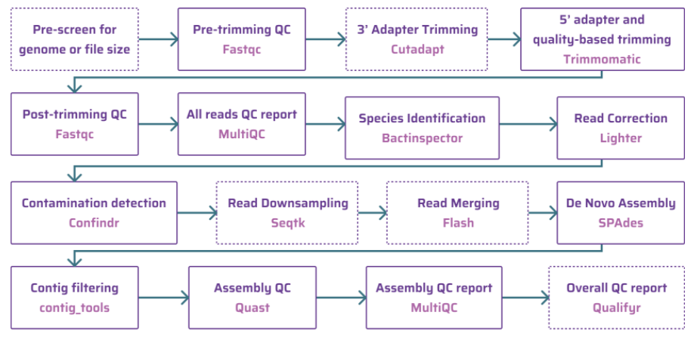

What are bioinformatics pipelines?
Raw sequence
Run assembly pipeline
Bioinformatician
(Happily ever after!)
Enthusiastic Bioinformatician
(Day 4)
Output

Slide 6
Benefits of pipelines
Automated steps
Portable
Reproducible
Bioinformatics pipelines
Ease of installation
Fast
Parallelization

Slide 7




GHRU Pipeline Architecture
Request analysis
Upload pipeline code
Run analysis; save results
GHRU Bioinformatician
Sentinel Bioinformatician
Download analysis results
Upload sequence files
Amazon cloud
computers
Cyberduck

Slide 8
Thank you

